Slide 1

Project Name : Chatbot for financial details of NSE listed companies
Submitted towards the partial fulfillment of the criteria for award of Post Graduate
In Data Analytics by Imarticus
Submitted By: Naresh Ganapathi
Course and Batch: PGAWE03

Slide 2
Scope &Objective
The scope of this project involves developing a chatbot that can provide users with real-time financial details and information about listed companies. The chatbot will be designed to interact with users in a conversational manner and retrieve relevant financial data from a reliable data source.

Slide 3
Business Problem Statement
The financial industry faces the challenge of providing quick and convenient access to real-time financial details of listed companies to investors, analysts, and stakeholders. Current methods of obtaining such information often involve manual searches and navigating complex financial databases, leading to inefficiencies and delays in decision-making processes. To address this issue, our objective is to develop an chatbot that can efficiently retrieve and deliver up-to-date financial information for listed companies.

Slide 4
Analytics Tools
Python is the language of choice and jupyter is the plotform for this project and the below packages of python will be used predominantly in this project.
Pandas
Yfinance
NLTK
Spacy
Gensim

Slide 5
Data source
The required financial details for company specified by the user are extracted from “yfinance” library,
As it is extracting data from Yahoo Finance website.
Manually prepared data used to train a model to have a basic conversation with the user.
Manual data used for services available in yfinance which can be extracted
Manual data used for Tickers which is need to be specified in yfinance in order to get the details of listed companies.

Slide 6
The following approaches are implemented in this project.
Gather a list of listed companies for which financial details will be provided,
Use the Yahoo Finance API to fetch real-time financial data, including latest stock prices, key financial metrics, and company information,
understanding the user intents using word@vec model,
Identifying required service for the user inputs through python function,
Capture the company details from the user inputs using "en_core_web_sm“ model,
Retrieve the needed reports from yfinance,
Providing the appropriate report to the user requested.

Slide 7
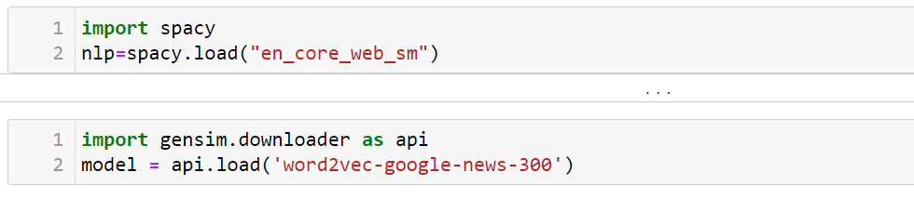
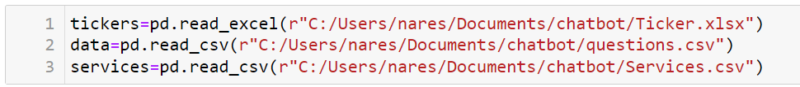
Library,Model and Dataset
Imported required models for the project
Imported all the required manual data prepared to train chatbot

Slide 8
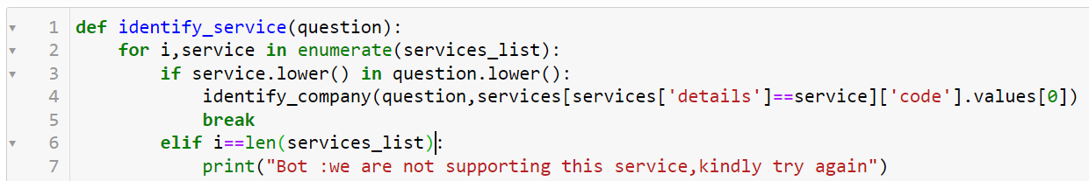
Approach
Created a list of services which can be provide to the user
User Defined function to recognize the service required for the user from the user inputs

Slide 9
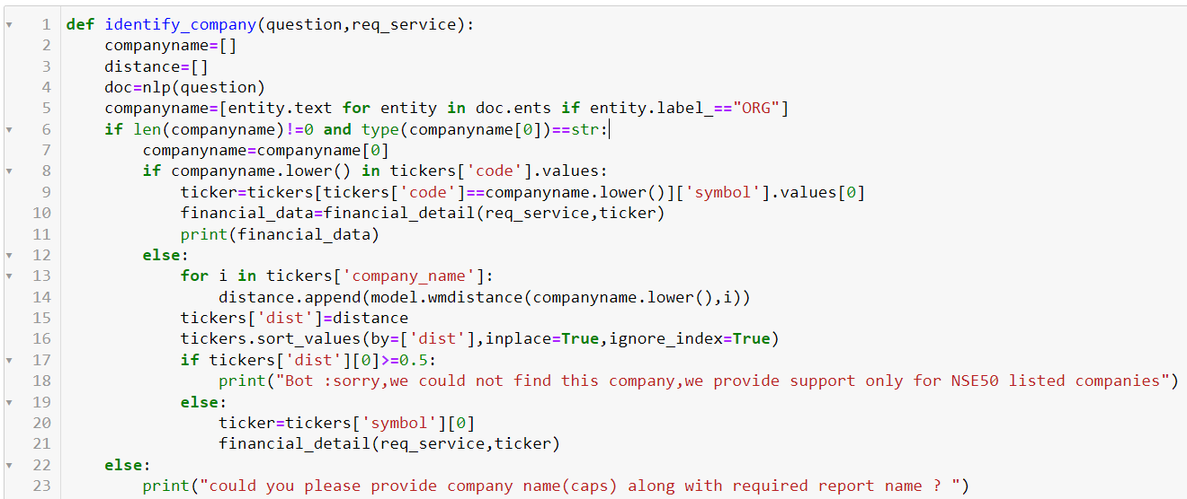
Approach
User Defined function to recognize the Company specified by the user from the user inputs
It will identify Entity name using "en_core_web_sm“ pretrained model and search it in Manual data imported.

Slide 10
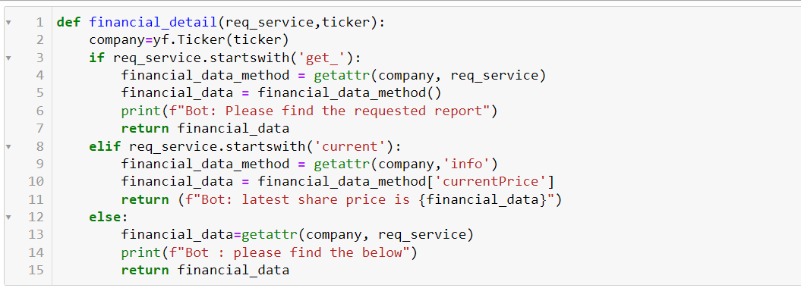
Approach
User Defined function to extract the Report specified by the user from the user inputs.

Slide 11
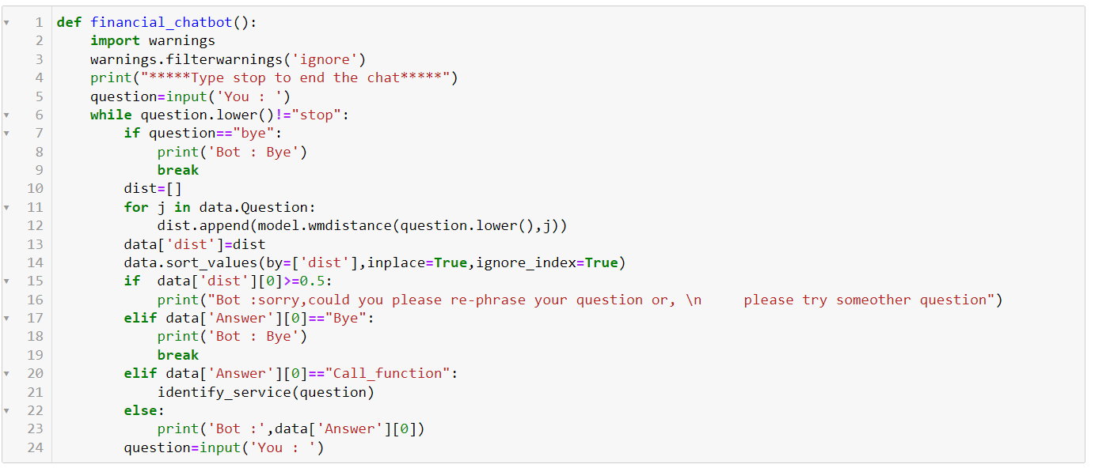
Approach
Final User defined function which will call other function and provide the output to the user.This is the Main Function used to communicate with the user.
We used 'word2vec-google-news-300’ model to find similarity score between user input and manually prepared expected questions from the user.

Slide 12
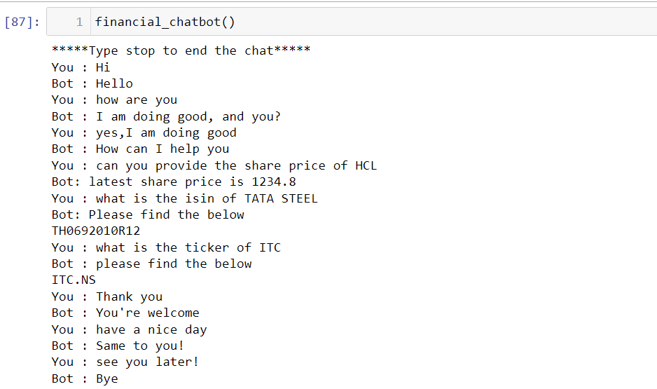
Result of Financial Chatbot
Conversation with the chatbot created.

Slide 13
KPIs, Timelines
KPI : Measure the accuracy of the chatbot's responses in providing financial information. Compare the chatbot's responses with the actual financial data from the Yahoo Finance API to assess the correctness of information.
Timeline : 2 Weeks

